Slide 1
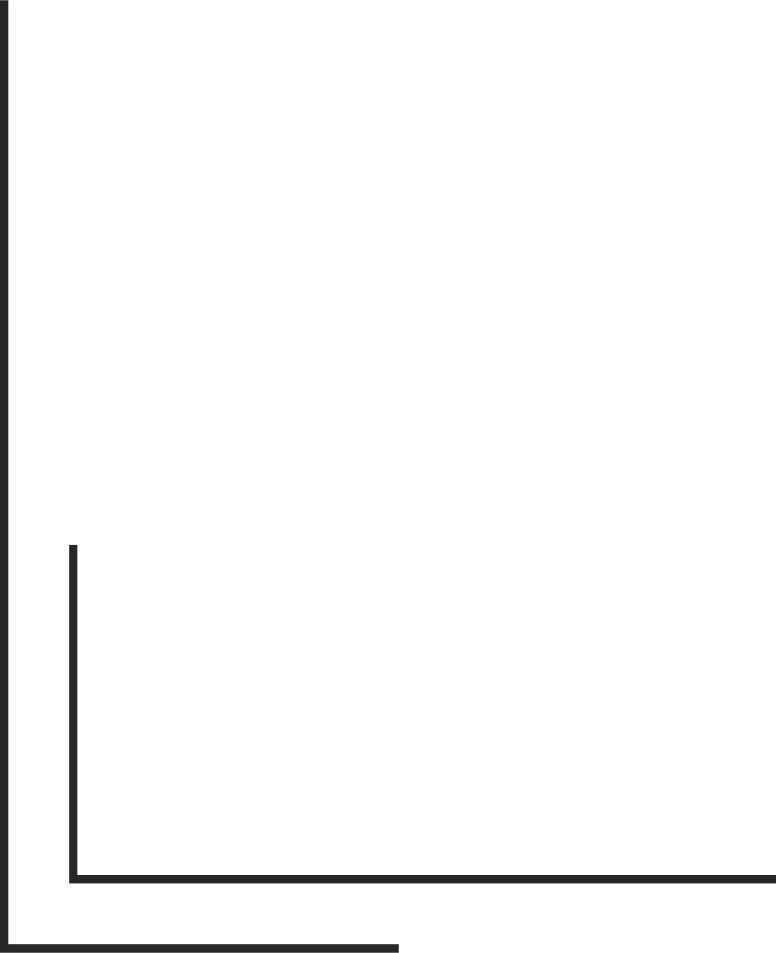
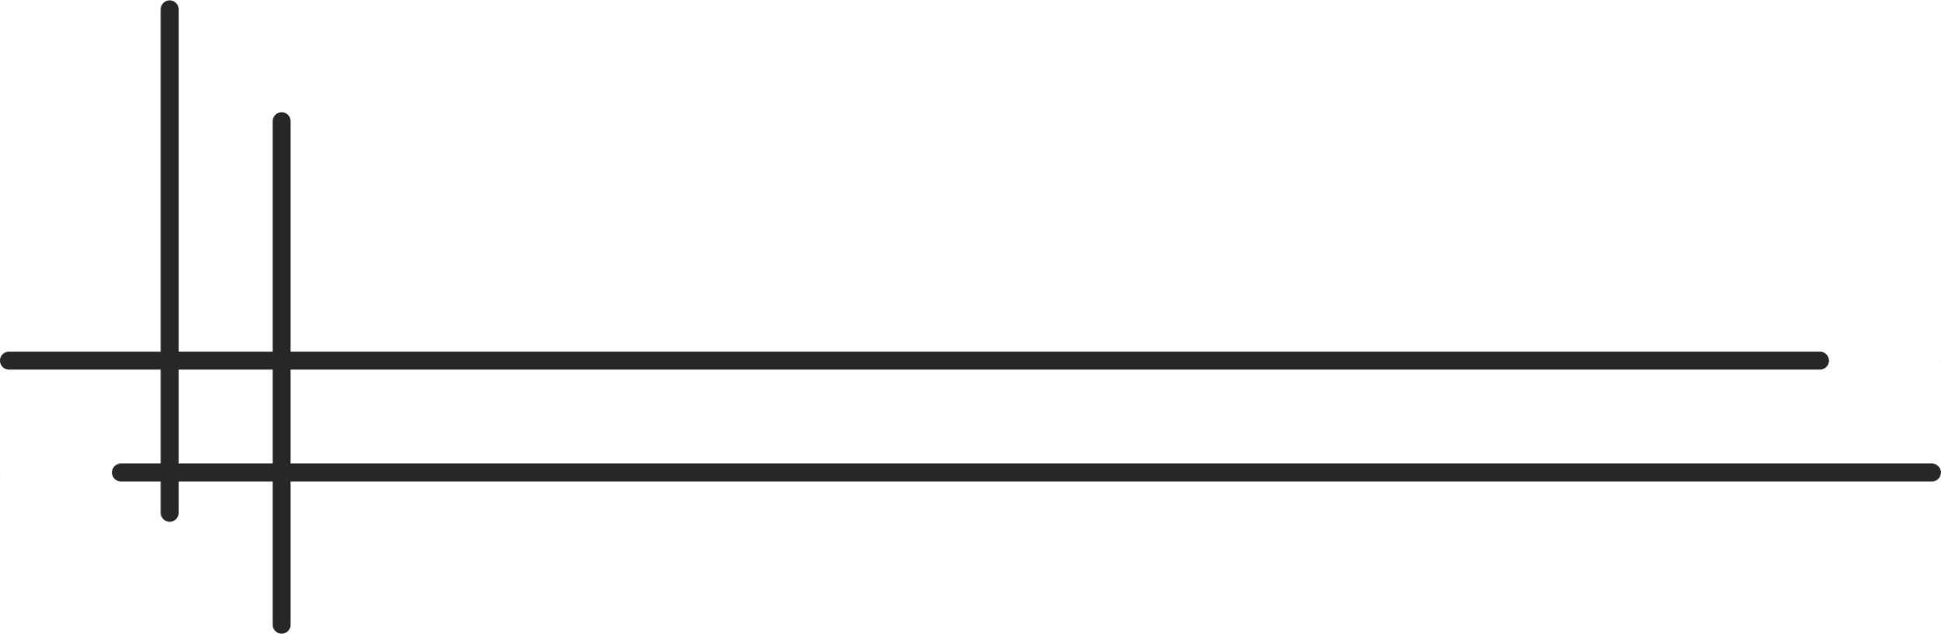
Sentiment Analysis of Bengali Book Reviews for Literay Insight
Presented By :
Israt Jahan Anika : 20210104136
Sanjana Akhter : 20210104150
Md. Mostafizur Rahman : 20210104151
Mahajabin Haque : 20210104154
Masnin Juairia : 20210104157

Slide 2

Table of contents
Introduction
Problem Statement
Research Objective
Related Works
Dataset
Data Preprocessing
Methodology
Evaluation Metrics
Result Analysis
Challenges and Limitation
Conclusion

Slide 3

Introduction
Sentiment analysis of Bengali text is becoming more popular because of the growing number of online book reviews. However, it is difficult to analyze Bengali sentiment because the language is complex and there aren’t enough high-quality datasets. Bengali also has many meanings that depend on context, which makes it harder to classify sentiment accurately.
This research focuses on using transformer-based models, including BanglaBERT, mBERT (Cased and Uncased), and XLM-RoBERTa, to analyze sentiment in Bengali book reviews

Slide 4

Problem Statement
Sentiment analysis of Bengali book reviews is challenging due to the complexity of the language and limited high-quality datasets.
It contains nuanced expressions, metaphors, and context-dependent meanings, making it difficult for traditional models to accurately capture sentiment.
Traditional machine learning models fail to capture the deep semantic meaning of Bengali text.
Data preprocessing is challenging due to mixed scripts, including Bengali and English characters.
Transformer-based models, can improve detection accuracy and help mitigate this issue.

Slide 5
Research Objective
Analyze the rise of Bengali book reviews on online platforms and their impact on reader sentiment.
Develop a sentiment analysis model using transformer-based models (BanglaBERT, mBERT, XLM-R).
Compare the performance of transformer models (BanglaBERT, mBERT, XLM-R) in accurately capturing sentiment nuances in Bengali text.
Evaluate model performance by addressing dataset imbalance and improving preprocessing techniques to enhance sentiment classification.

Slide 6
Related Works
Kabir et al. (2023): Introduced BanglaBook, a large-scale dataset for sentiment analysis of Bengali book reviews. BanglaBERT achieved the highest accuracy of 88.5% for sentiment classification.
Hira et al. (2022): Conducted a systematic review of sentiment analysis from Bengali text using NLP. Transformer-based models consistently outperformed traditional machine learning approaches.
Khan et al. (2022): Collected 5,500 Bengali book reviews and tested models like AdaBoost, Decision Tree, Random Forest, SVM, and LightGBM. Random Forest achieved the highest accuracy of 99.39%.
Gobinda Chandra Sarker et al. (2022): Developed a dataset of 5,189 Bangla book reviews and tested multiple models (LSTM, BiLSTM, CNN-LSTM, CNN-BiLSTM) and transformer models (mBERT, BanglaBERT, XLM-R). XLM-R showed the best performance with an F1 score of 88.95%.
Khatun et al. (2022): Analyzed 10,000 Bengali book reviews using Decision Tree, Random Forest, and CNN. Random Forest provided the best accuracy, reaching 85%.

Slide 7
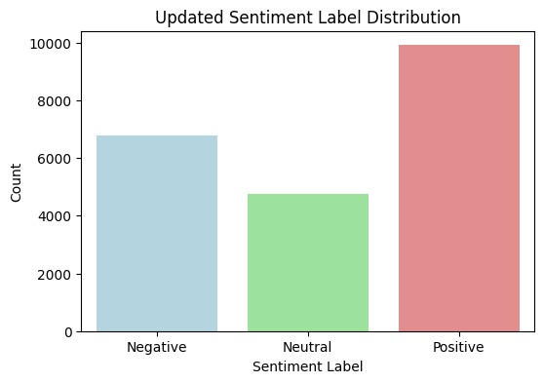
Dataset
Contains 110,645 Bengali book reviews with sentiment labels ("positive," "negative," and "neutral").
Imbalanced dataset (99,110 positive, 6,772 negative, 4,763 neutral).
After resampling, the final dataset contains 21,446 samples (9,911 positive, 6,672 negative, and 4,763 neutral).
Split into training (80%) and testing (20%) for model evaluation.

Slide 8
Data Preprocessing
Text Cleaning: Removed English words, emojis, numbers, and extra spaces to retain only Bengali text.
Attribute Selection: Retained key attributes like rating (1–5), review text, sentiment (positive, negative, or neutral), and label (0 = negative, 1 = neutral, 2 = positive) for sentiment classification.
Class Imbalance Handling: Reduced the positive class to 10% of its original size to address class imbalance, resulting in 21,446 samples (9,911 positive, 6,672 negative, and 4,763 neutral).
Tokenization: Used BanglaBERT tokenizer for subword tokenization with a maximum sequence length of 128. Padding and truncation were applied to standardize input size.

Slide 9
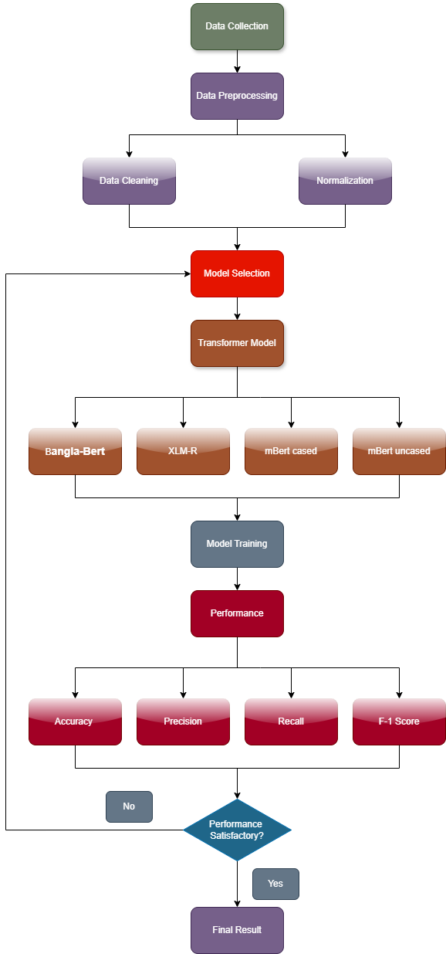
Methodology
A. Transformer-Based Models:
BanglaBERT: Trained on a large Bengali corpus, fine-tuned for better language understanding.
mBERT:
Trained on 104 languages (including Bengali).
Cased: Retains capitalization, helps with tokenization.
Uncased: Normalizes case, improves tokenization.
XLM-RoBERTa: Multilingual model, handles code-mixed text but underperforms for Bengali.
B. Feature Selection
Input Features:
Rating: Numeric value (1 to 5), normalized.
Review: Actual review text, tokenized for model input.
Target Variable:
0 → Negative
1 → Neutral
2 → Positive

Slide 10
Methodology
C. Hyperparameter Tuning:
Batch Size: 16 (tested 8 for memory efficiency).
Learning Rate: 2e-5 (tested 1e-5 for stable training).
Weight Decay: 0.01 (tested 0.02 to prevent overfitting).
Epochs: 5 (tested up to 7, no major improvement).
Evaluation: Performance assessed after each epoch.
D. Model Evaluation
Assessed models using accuracy, precision, recall, F1-score, and confusion matrix.

Slide 11
Evaluation Metrics
Accuracy: Indicates the proportion of correctly classified reviews.
Precision: Reflects the model's effectiveness in accurately detecting book reviews.
Recall: Measures the model’s capability to capture all instances of book reviews.
F1-Score: Serves as a harmonic mean, balancing precision and recall.

Slide 12
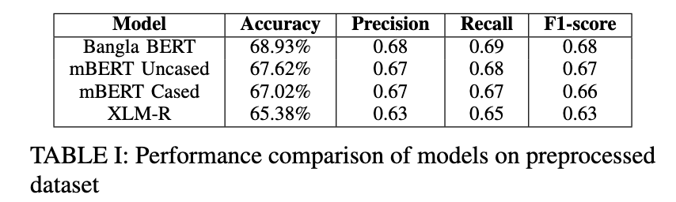
Result Analysis

Slide 13
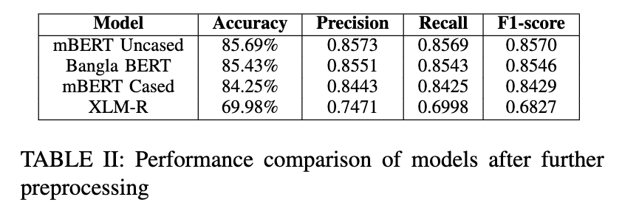
Result Analysis

Slide 14
Challenges and Limitations:
Data Imbalance: More positive reviews than negative and neutral reviews affect model accuracy.
Language Complexity: Bengali’s complex grammar, sarcasm, and cultural nuances make sentiment analysis difficult.
Computational Cost: Transformer models need high processing power.
Model Overfitting: Overfitting risk due to limited diversity in the dataset.
Performance: Initially on preprocessed dataset the performance of the models were poor.

Slide 15
Conclusion
Our research shows that transformer-based models, particularly mBERT (Cased) and BanglaBERT showed the best performance with high accuracy and low validation loss. XLM-RoBERTa also performed well, proving that both language-specific and multilingual models can handle Bengali sentiment analysis.

Slide 16
Thank You

